Slide 1

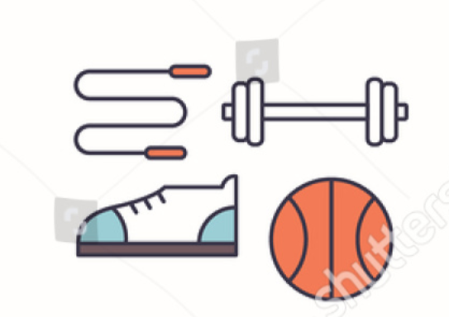

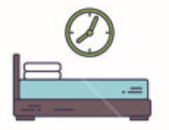
Healthy Habits Monitor
Leonardo Falcon Izzi
Graham Flinchum
Sweta Rout

Slide 2
Goals
EAT HEALTHY
Automated non-invasive
system that monitors health habits
in the home.
Classify based on training data
gathered by us and our peers
against various studies in the field of health.
Provide feedback to users
as to how healthy their habits are.
HEALTHY LIFE
DRINK PLENTY OF WATER
EXERCISE REGULARLY
SLEEP WELL
REDUCE
STATIONARY TIME

Slide 3
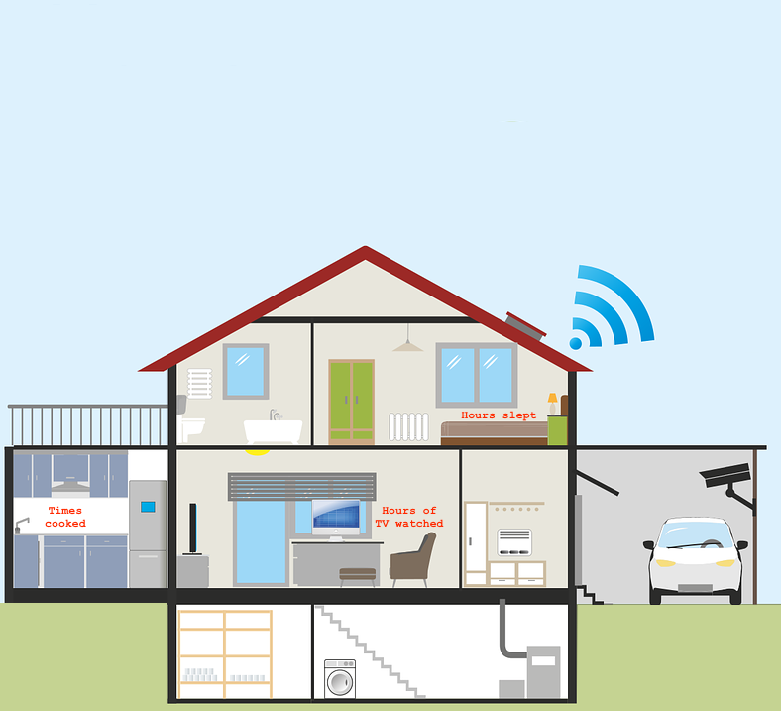
Smart home
SVM Classifier
Display on a web page

Slide 4
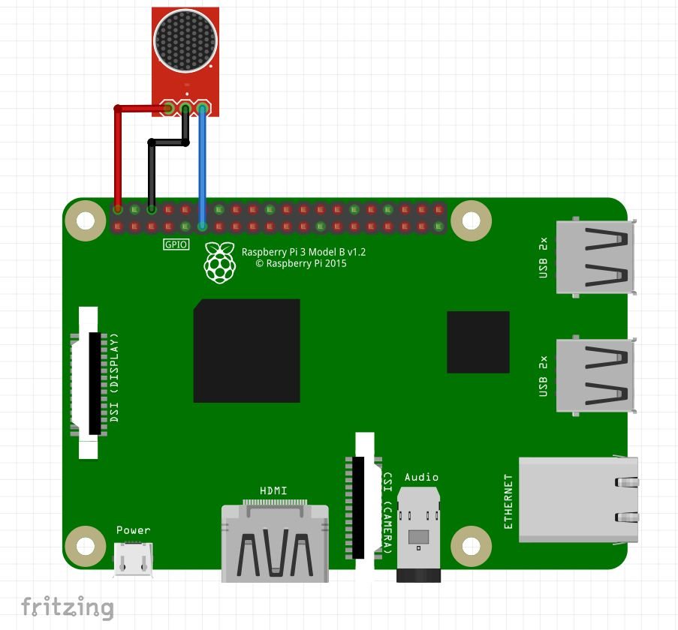
TV Tracker
5V microphone with adjustable sensitivity connected to Raspberry Pi
Sound detection triggers a timer, which will calculate the total TV time if it expires before another sound is detected
Normalizes values and sends total hours watching TV to Bluemix once a day

Slide 5
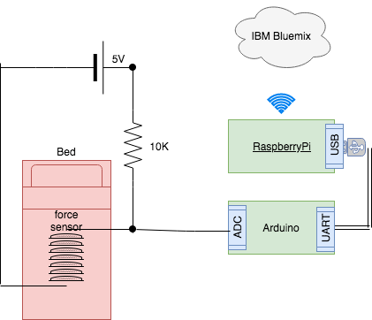

Sleep tracker
Resistive force sensor in voltage divider configuration
Arduino serving as ADC
Raspberry PI implements a moving average filter.
Runs sleep detection algorithm.
Publishes hours slept to IBM bluemix cloud once a day.

Slide 6
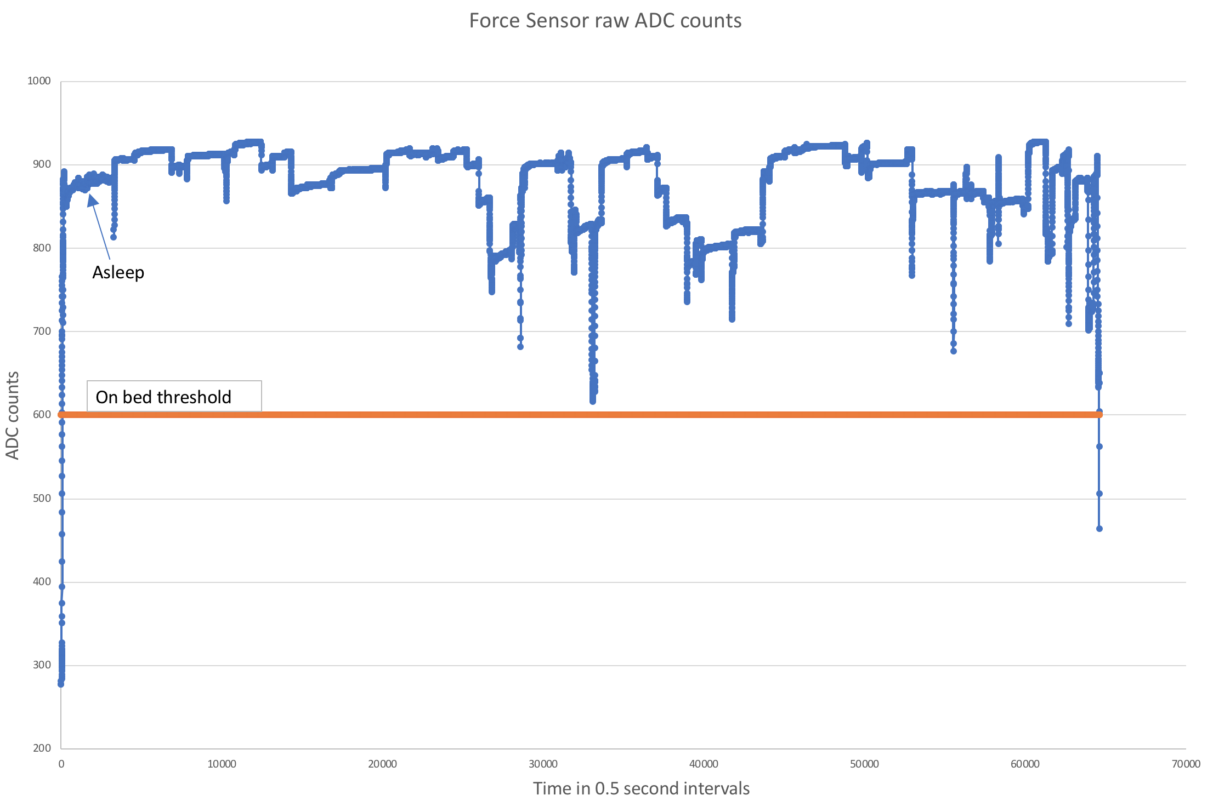
Sleep tracker data example

Slide 7
Morning Snack
Lunch
Eat 5 meals a day and always have a breakfast
Breakfast
Afternoon Snack
Dinner

Slide 8
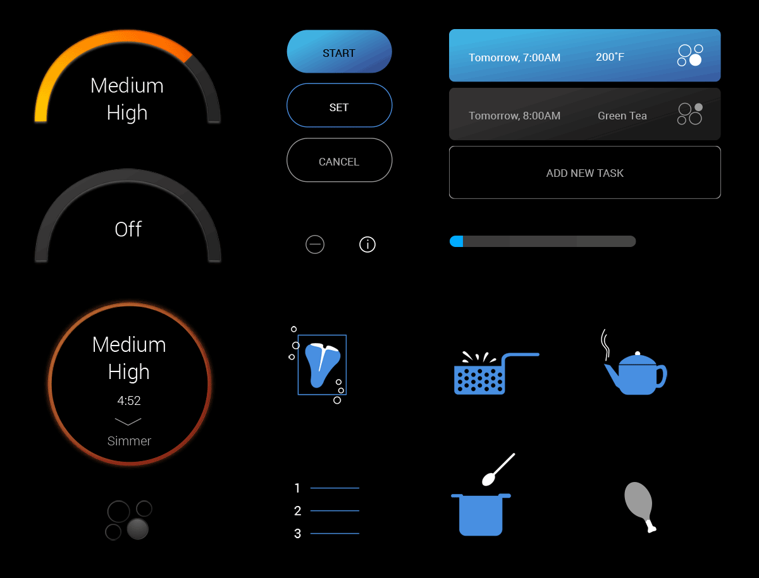
What is a Smart Stove ?
What we achieved ?
Temperature :
Stove On/Off (Used for Project)
On : Temp >130
Off : Temp <130
Temperature of the stove(Not in scope but displays in Pi Console)
Low : 110 to 130
Low Medium : 130 to 150
Medium : 150 to 180
High Medium : 180 to 200
High : >200

Slide 9
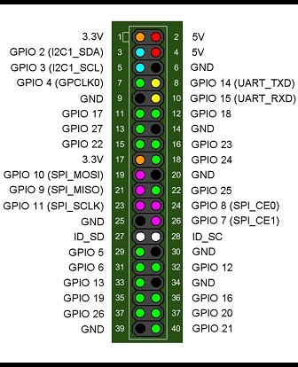
Cooking times counter
4.7k Resistor
VDD
DS18B20 Sensor
DQ
GND

Slide 10
Sleep Tracker
Meals Tracker
TV Tracker
Automated tracking:
Monitors cooking habits
Normalise values
Publishes number of cooked meals per day
Monitors watching TV
Normalise values
Publishes number of hours of entertainment per day
Monitors Sleep
Normalise values
Publishes the hours of sleep per day
Subscribe to events from raspberry pi (sleep,meals,tv)
IBM Bluemix:
Automated: time slept, number of meals, time watching tv.
Manual: Water drank, minutes of exercise
Classes:
Features (per day basis):
Not Healthy
Below Average
Average
Healthy
SVM Classifier
Display on a web page

Slide 11
